Slide 1
Chapter 7: Entity-Relationship Model

Slide 2
Chapter 7: Entity-Relationship Model
Design Process
Outline of the ER Model
Constraints
Redundant Attributes
E-R Diagram
Design Issues
Extended E-R Features
Design Process
Reduction to Relation Schemas

Slide 3
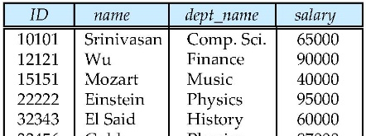
数据库设计与实现全过程
数据需求
E-R设计
关系模式规范化
关系模式设计
1、有无各种数据异常？
2、符合哪级范式？
3、是否需要改造为更高范式？
4、进一步改造修正关系模式的设计直至符合要求。
instructor (ID, name, dept_name, salary )
student(ID, name, dept_name,tot_cred)
advisor(s_ID,i_ID)
department(dept_name,building, budget)
数据库定义
数据库存储
create table instructor (ID varchar(5),……)
create table student(ID varchar(5),……)
create table advisor(s_ID varchar(5),……)
create table department(dept_name……)

Slide 4
Design Phases

Slide 5
Design Phases
The initial phase of database design is to characterize fully the data needs of the prospective database users.
Next, the designer chooses a data model and, by applying the concepts of the chosen data model, translates these requirements into a conceptual schema of the database.
A fully developed conceptual schema also indicates the functional requirements of the enterprise. In a “specification of functional requirements”, users describe the kinds of operations (or transactions) that will be performed on the data.
Notes:
5

Slide 6
Design Phases (Cont.)
The process of moving from an abstract data model to the implementation of the database proceeds in two final design phases.
Logical Design – Deciding on the database schema. Database design requires that we find a “good” collection of relation schemas.
Business decision – What attributes should we record in the database?
Computer Science decision – What relation schemas should we have and how should the attributes be distributed among the various relation schemas?
Physical Design – Deciding on the physical layout of the database
Notes:
6

Slide 7
Design Approaches
Entity Relationship Model (covered in this chapter)
Models an enterprise as a collection of entities and relationships
Entity: a “thing” or “object” in the enterprise that is distinguishable from other objects
Described by a set of attributes
Relationship: an association among several entities
Represented diagrammatically by an entity-relationship diagram:
Normalization Theory (Chapter 8)
Formalize what designs are bad, and test for them
Notes:
7

Slide 8
Outline of the ER Model

Slide 9
Modeling
A database can be modeled as:
a collection of entities,
relationship among entities.
An entity is an object that exists and is distinguishable from other objects.
Example: specific person, company, event, plant
Entities have attributes
Example: people have names and addresses
An entity set is a set of entities of the same type that share the same properties.
Example: set of all persons, companies, trees, holidays

Slide 10
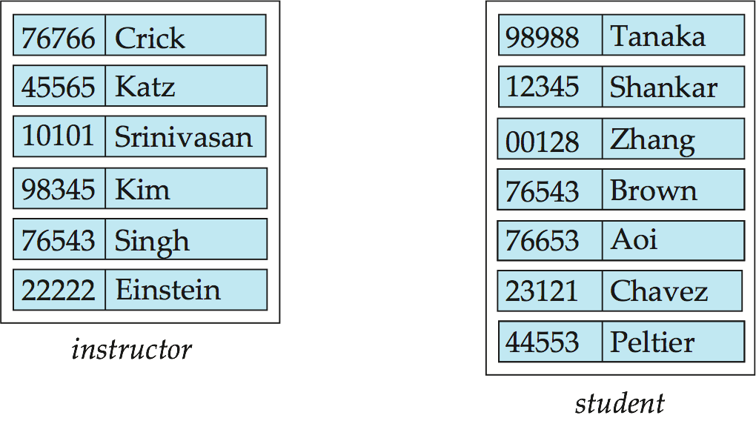
Entity Sets instructor and student
instructor_ID instructor_name student-ID student_name

Slide 11
Relationship Sets
A relationship is an association among several entities
Example: 44553 (Peltier) advisor 22222 (Einstein) student entity relationship set instructor entity
A relationship set is a mathematical relation among n ≥ 2 entities, each taken from entity sets
{(e₁, e₂, … e_{n}) | e₁ ∈ E₁, e₂ ∈ E₂, …, e_{n} ∈ E_{n}} where (e₁, e₂, …, e_{n}) is a relationship
Example:
(44553,22222) ∈ advisor

Slide 12
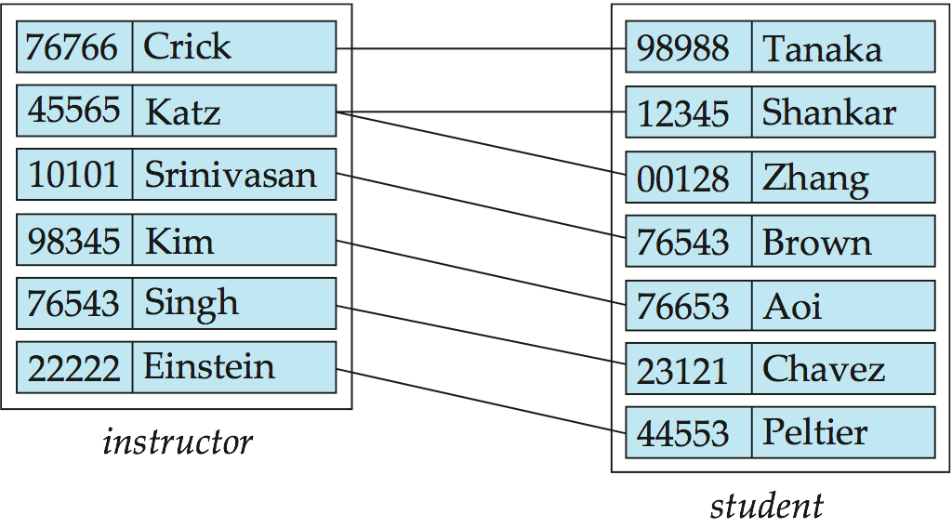
Relationship Set advisor

Slide 13
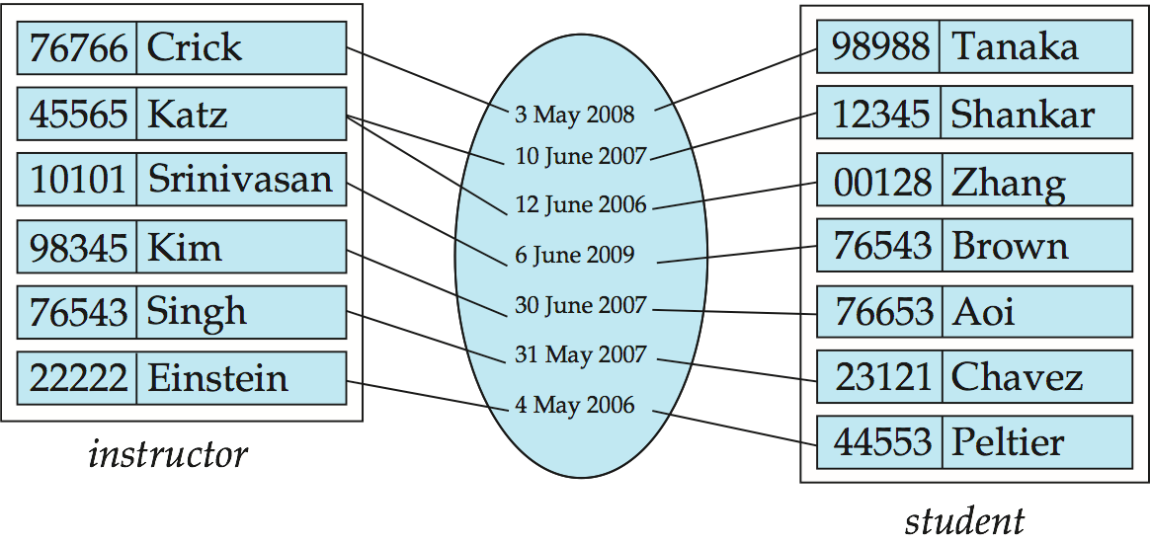
Relationship Sets (Cont.)
An attribute can also be property of a relationship set.
For instance, the advisor relationship set between entity sets instructor and student may have the attribute date which tracks when the student started being associated with the advisor

Slide 14
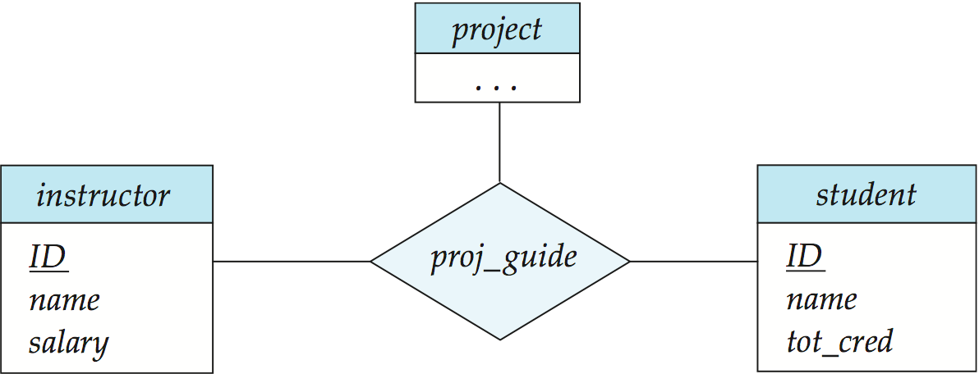
Degree of a Relationship Set
Binary Relationship
involve two entity sets (or degree two).
most relationship sets in a database system are binary.
Relationships between more than two entity sets are rare. Most relationships are binary. (More on this later.)
Example: students work on research projects under the guidance of an instructor.
relationship proj_guide is a ternary relationship between instructor, student, and project

Slide 15
Attributes
An entity is represented by a set of attributes, that is descriptive properties possessed by all members of an entity set.
Example:
instructor = (ID, name, street, city, salary ) course= (course_id, title, credits)
Domain – the set of permitted values for each attribute
Attribute types:
Simple and composite attributes.
Single-valued and multivalued attributes
Example: multivalued attribute: phone_numbers
Derived attributes
Can be computed from other attributes
Example: age, given date_of_birth

Slide 16
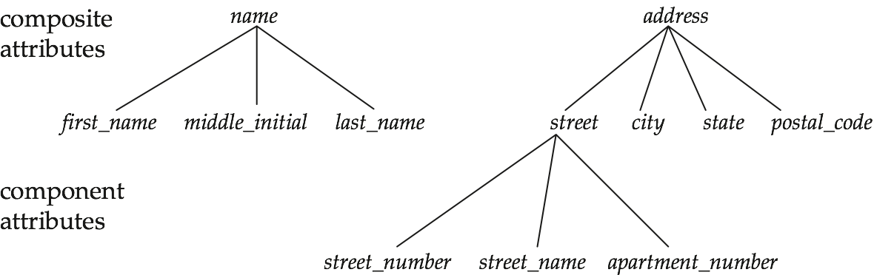
Composite Attributes

Slide 17
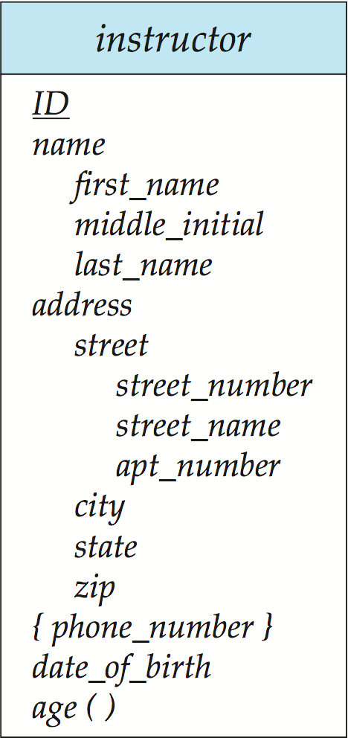
Entity With Composite, Multivalued, and Derived Attributes
Composite Attributes
Multivalued Attributes
Derived Attributes

Slide 18
Constraints

Slide 19
Mapping Cardinality Constraints
Express the number of entities to which another entity can be associated via a relationship set.
Most useful in describing binary relationship sets.
For a binary relationship set the mapping cardinality must be one of the following types:
One to one
One to many
Many to one
Many to many

Slide 20
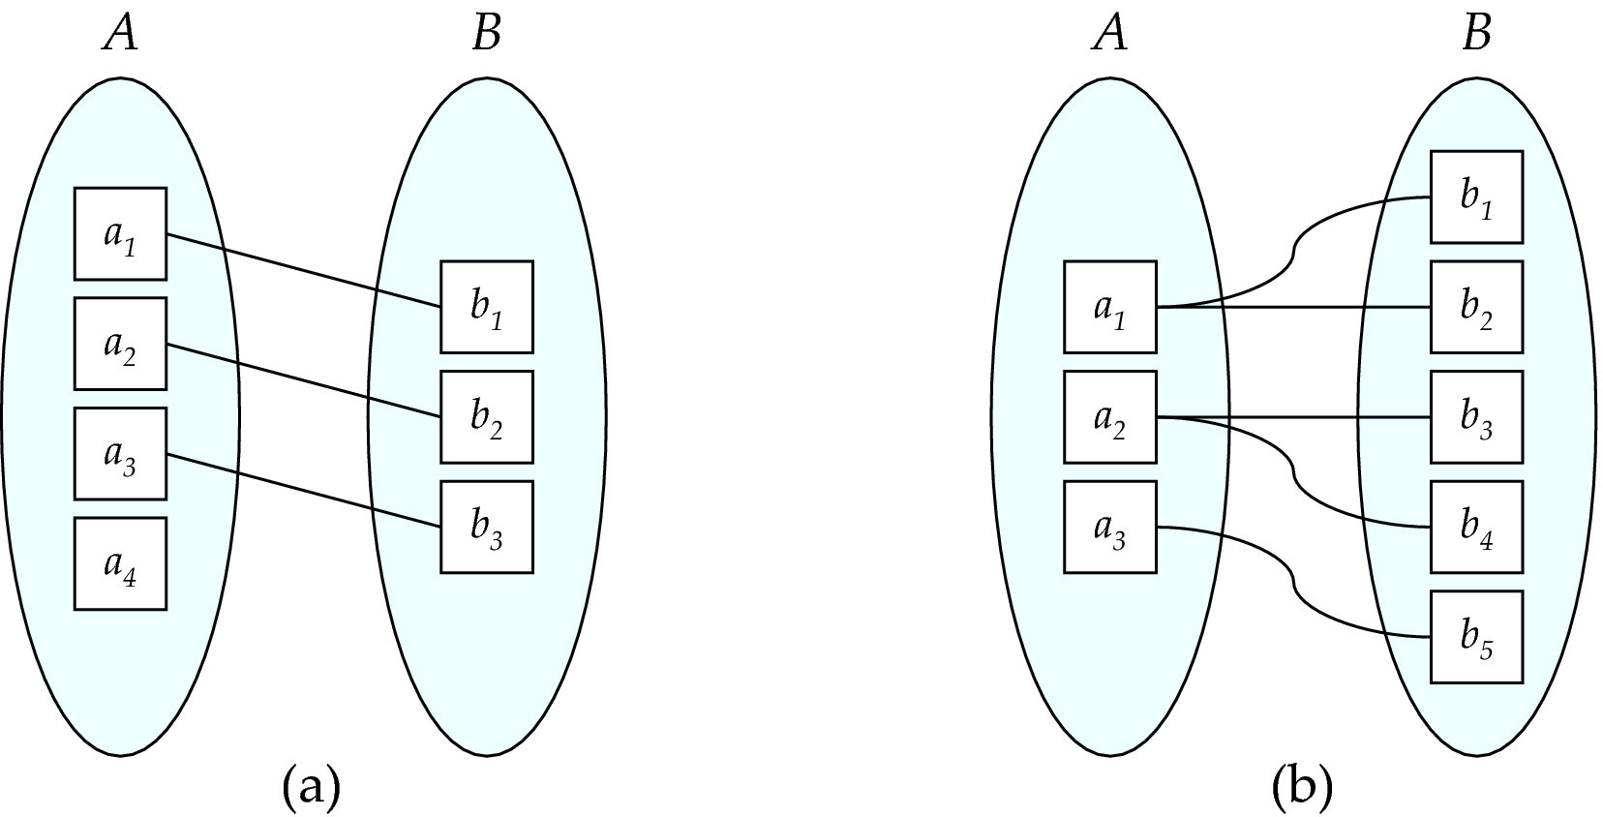
Mapping Cardinalities
One to one
One to many
Note: Some elements in A and B may not be mapped to any
elements in the other set

Slide 21
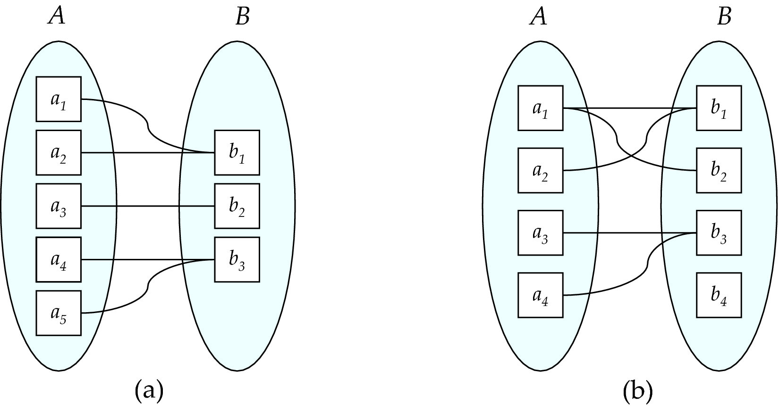
Mapping Cardinalities
Many to one
Many to many
Note: Some elements in A and B may not be mapped to any
elements in the other set

Slide 22
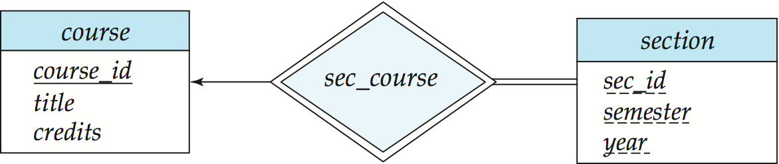
Participation of an Entity Set in a Relationship Set
Total participation (indicated by double line): every entity in the entity set participates in at least one relationship in the relationship set
E.g., participation of section in sec_course is total
every section must have an associated course
Partial participation: some entities may not participate in any relationship in the relationship set
Example: participation of instructor in advisor is partial
Partial participation
Total participation

Slide 23
Keys
A super key of an entity set is a set of one or more attributes whose values uniquely determine each entity.
A candidate key of an entity set is a minimal super key
ID is candidate key of instructor
course_id is candidate key of course
Although several candidate keys may exist, one of the candidate keys is selected to be the primary key.

Slide 24
Keys for Relationship Sets
The combination of primary keys of the participating entity sets forms a super key of a relationship set.
(s_id, i_id) is the super key of advisor
NOTE: this means a pair of entity sets can have at most one relationship in a particular relationship set.
Example: if we wish to track multiple meeting dates between a student and her advisor, we cannot assume a relationship for each meeting. We can use a multivalued attribute though
Must consider the mapping cardinality of the relationship set when deciding what are the candidate keys
Need to consider semantics of relationship set in selecting the primary key in case of more than one candidate key

Slide 25
Redundant Attributes

Slide 26
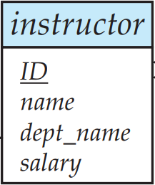
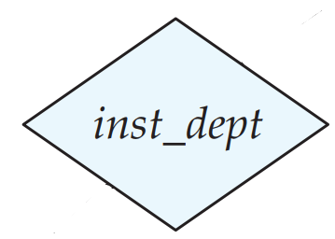
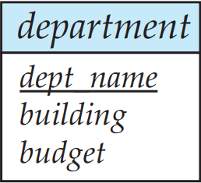
Redundant Attributes
Suppose we have entity sets:
instructor, with attributes: ID, name, dept_name, salary
department, with attributes: dept_name, building, budget
We model the fact that each instructor has an associated department using a relationship set inst_dept

Slide 27
Redundant Attributes
The attribute dept_name appears in both entity sets. Since it is the primary key for the entity set department, it replicates information present in the relationship and is therefore redundant in the entity set instructor and needs to be removed.
BUT: when converting back to tables, in some cases the attribute gets reintroduced, as we will see later.

Slide 28
Entity-Relationship Diagrams

Slide 29
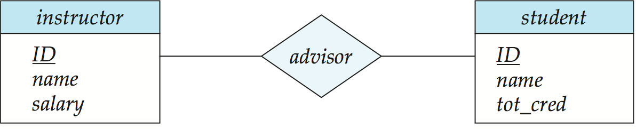
Basic E-R Diagrams
Rectangles divided into two parts represent entity sets. The first part, which in this textbook is shaded blue, contains the name of the entity set. The second part contains the names of all the attributes of the entity set.
Diamonds represent relationship sets.
Lines link entity sets to relationship sets.

Slide 30
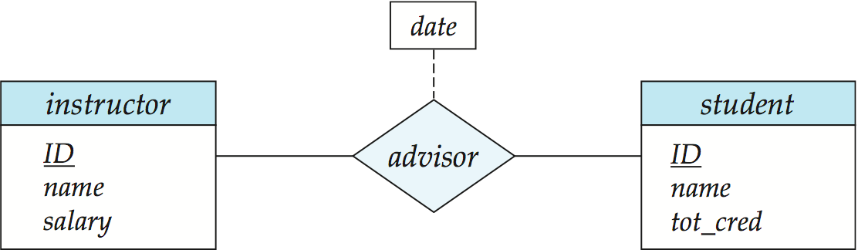
Relationship Sets with Attributes
Undivided rectangles represent the attributes of a relationship set. Attributes that are part of the primary key are underlined.
Dashed lines link attributes of a relationship set to the relationship set.

Slide 31
Cardinality Constraints
We express cardinality constraints by drawing either a directed line (→), signifying “one,” or an undirected line (—), signifying “many,” between the relationship set and the entity set.

Slide 32
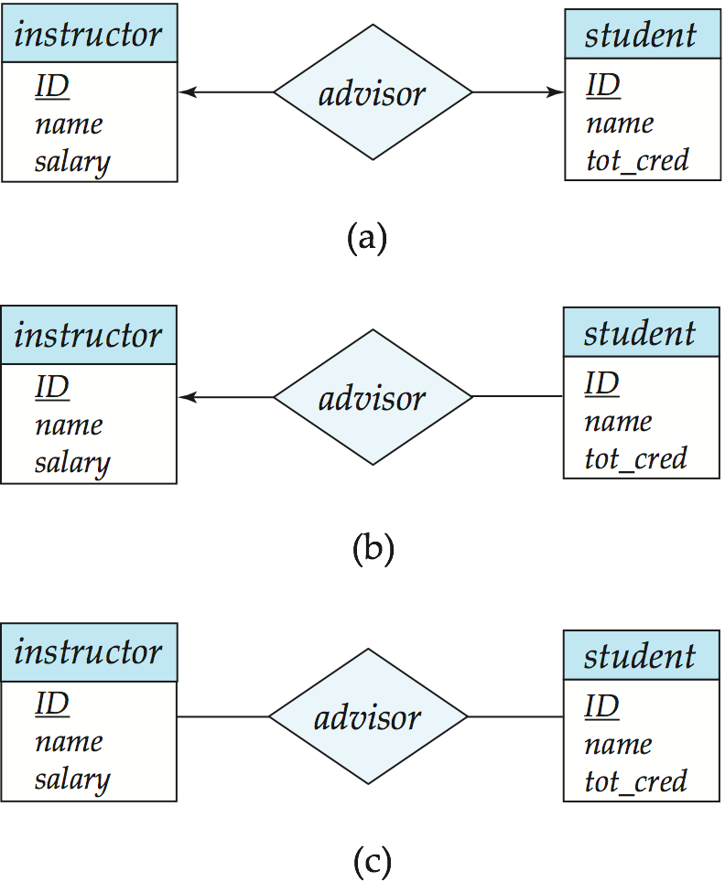
One-to-One Relationship
one-to-one relationship between an instructor and a student
an instructor is associated with at most one student via advisor
and a student is associated with at most one instructor via advisor

Slide 33
One-to-Many Relationship
one-to-many relationship between an instructor and a student
an instructor is associated with several (including 0) students via advisor
a student is associated with at most one instructor via advisor,

Slide 34
Many-to-One Relationships
In a many-to-one relationship between an instructor and a student,
an instructor is associated with at most one student via advisor,
and a student is associated with several (including 0) instructors via advisor

Slide 35

Many-to-Many Relationship
An instructor is associated with several (possibly 0) students via advisor
A student is associated with several (possibly 0) instructors via advisor

Slide 36
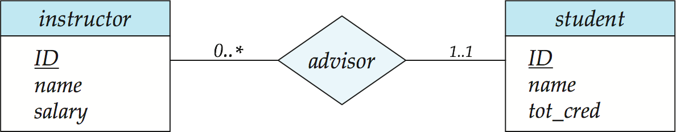
Alternative Notation for Cardinality Limits
Cardinality limits can also express participation constraints

Slide 37
Entity With Composite, Multivalued, and Derived Attributes
Composite Attributes
Multivalued Attributes
Derived Attributes

Slide 38
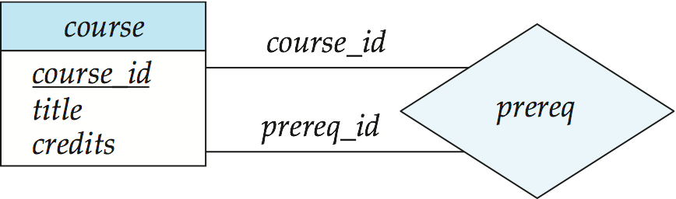
Roles
Entity sets of a relationship need not be distinct
Each occurrence of an entity set plays a “role” in the relationship
The labels “course_id” and “prereq_id” are called roles.

Slide 39
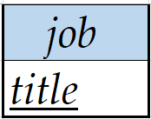
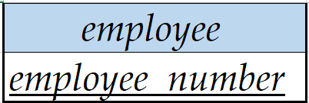
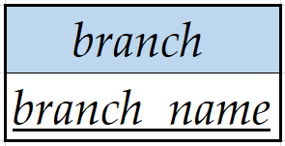
Ternary Relationship
(a)
works_on
(b)

Slide 40
Weak Entity Sets
An entity set that does not have a primary key is referred to as a weak entity set.
The existence of a weak entity set depends on the existence of a identifying entity set
It must relate to the identifying entity set via a total, one-to-many relationship set from the identifying to the weak entity set
Identifying relationship depicted using a double diamond
The discriminator (or partial key) of a weak entity set is the set of attributes that distinguishes among all the entities of a weak entity set.
The primary key of a weak entity set is formed by the primary key of the strong entity set on which the weak entity set is existence dependent, plus the weak entity set’s discriminator.

Slide 41

Weak Entity Sets (Cont.)
We underline the discriminator of a weak entity set with a dashed line.
We put the identifying relationship of a weak entity in a double diamond.
Primary key for section – (course_id, sec_id, semester, year)

Slide 42
Weak Entity Sets (Cont.)
Note: the primary key of the strong entity set is not explicitly stored with the weak entity set, since it is implicit in the identifying relationship.
If course_id were explicitly stored, section could be made a strong entity, but then the relationship between section and course would be duplicated by an implicit relationship defined by the attribute course_id common to course and section

Slide 43
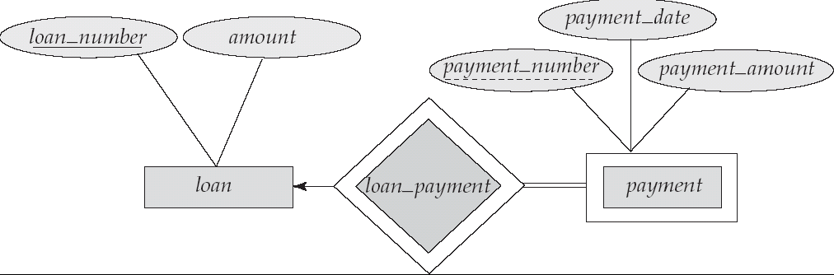
Weak Entity Sets (Another Example)
payment_number – discriminator of the payment entity set
Primary key for payment – (loan_number, payment_number)

Slide 44
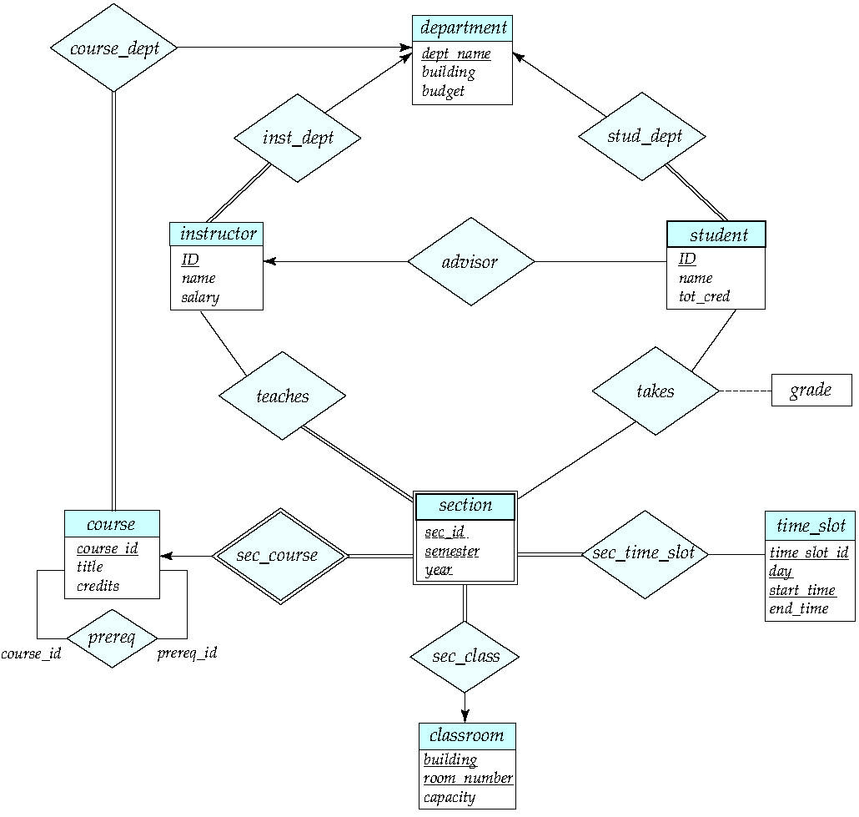
E-R Diagram for a University Enterprise
Figure 7.15

Slide 45
Design Issues

Slide 46
Design Issues
Use of entity sets vs. attributes Choice mainly depends on the structure of the enterprise being modeled, and on the semantics associated with the attribute in question.
Use of entity sets vs. relationship sets Possible guideline is to designate a relationship set to describe an action that occurs between entities
Binary versus n-ary relationship sets Although it is possible to replace any nonbinary (n-ary, for n > 2) relationship set by a number of distinct binary relationship sets, a n-ary relationship set shows more clearly that several entities participate in a single relationship.
Placement of relationship attributes

Slide 47
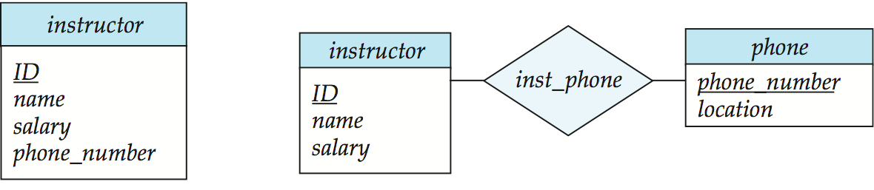
Use of entity sets vs. attributes
Use of phone as an entity allows extra information about phone numbers (plus multiple phone numbers)

Slide 48
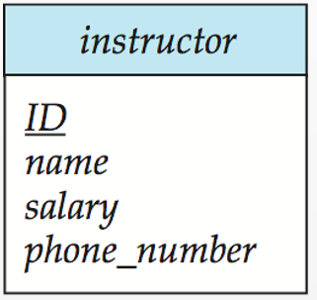
Use of entity sets vs. attributes
ID | name | salary | phone numbers
1 | Jones | 72000 | 602-346-356
2 | Smith | 98000 | 843-235-575
2 | Smith | 98000 | 843-089-234
3 | Williams | 82000 | 602-346-356
ID | name | salary | phone numbers1 | phone numbers2
1 | Jones | 72000 | 602-346-356 | null
2 | Smith | 98000 | 843-235-575 | 843-089-234
3 | Williams | 82000 | 602-346-356 | null
(a)

Slide 49
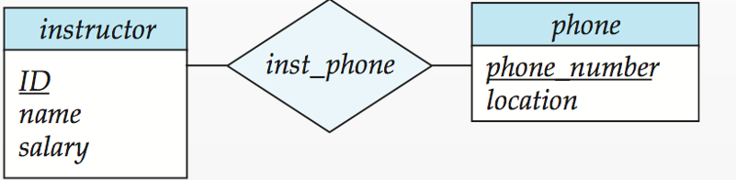
Use of entity sets vs. attributes
ID | name | salary
1 | Jones | 72000
2 | Smith | 98000
3 | Williams | 82000
ID | phone numbers
1 | 602-346-356
2 | 843-089-234
2 | 843-235-575
3 | 602-346-356
phone numbers | location
602-346-356 | Taylor 3128
843-235-575 | Watson 100
843-089-234 | Packard 101
(b)

Slide 50
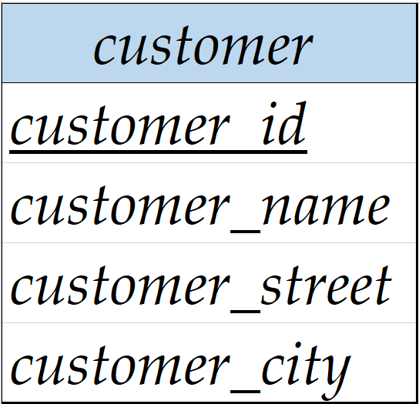
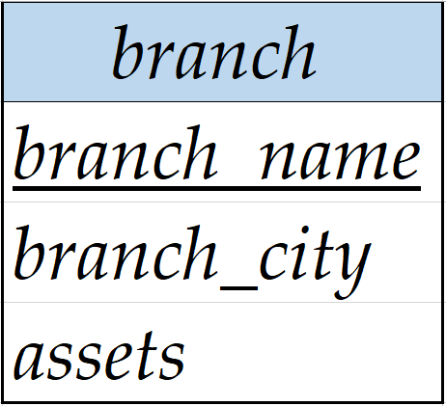
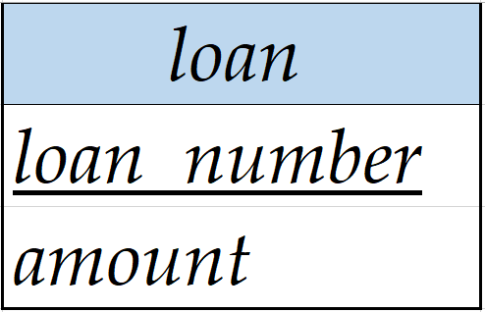
Use of entity sets vs. relationship sets
loan_number
loan
amount
borrower
loan-branch

Slide 51
Use of entity sets vs. relationship sets
If every loan is held by exactly one customer and is associated with exactly one branch, the above design is satisfied.
customer-id | loan-number | branch-name | amount
1 | L-12 | Downtown | 250
2 | L-11 | Redwood | 900
3 | L-14 | Perryridge | 1500
If several customers hold a loan jointly, we must replicate the values for the descriptive attributes such as loan_number and amount.
customer-id | loan-number | branch-name | amount
1 | L-12 | Downtown | 250
2 | L-11 | Redwood | 900
3 | L-12 | Downtown | 250

Slide 52
Binary Vs. Non-Binary Relationships
Some relationships that appear to be non-binary may be better represented using binary relationships
Example: proj_guide

Slide 53
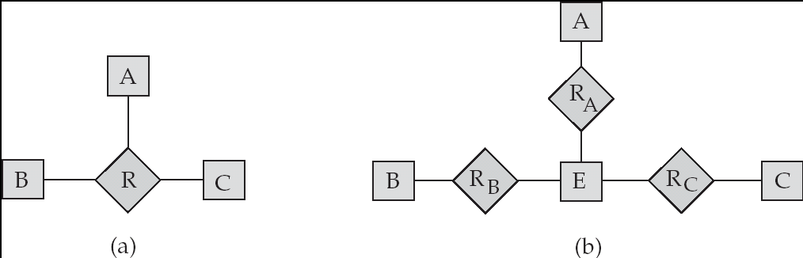
Converting Non-Binary Relationships to Binary Form
In general, any non-binary relationship can be represented using binary relationships by creating an artificial entity set.
Replace R between entity sets A, B and C by an entity set E, and three relationship sets:
1. R_{A}, relating E and A 2.R_{B}, relating E and B
3. R_{C}, relating E and C
Create a special identifying attribute for E
Add any attributes of R to E
For each relationship (a_{i} , b_{i} , c_{i}) in R, create
1. a new entity e_{i} in the entity set E 2. add (e_{i} , a_{i} ) to R_{A}
3. add (e_{i} , b_{i} ) to R_{B} 4. add (e_{i} , c_{i} ) to R_{C}

Slide 54
Converting Non-Binary Relationships to Binary Form
instructor | student | pro
Ada | Dan | m
Jones | Dan | a
Jones | Peter | n
E | instructor
1 | Ada
2 | Jones
3 | Jones
E | student
1 | Dan
2 | Dan
3 | Peter
E | pro
1 | m
2 | a
3 | n
The extra relationship sets and its attributes may increase the complexity of the design and overall storage requirements.
A n-ary relationship set shows more clearly that several entities participate in a single relationship.

Slide 55
Placement of relationship attributes
The cardinality ratio of a relationship can affect the placement of relationship attributes.
For instance, the attribute date specifies when the instructor became the advisor of a student.
Suppose that advisor is a one-to-many relationship set such that one instructor may advise several students, but each student can be advised by only a single instructor.

Slide 56
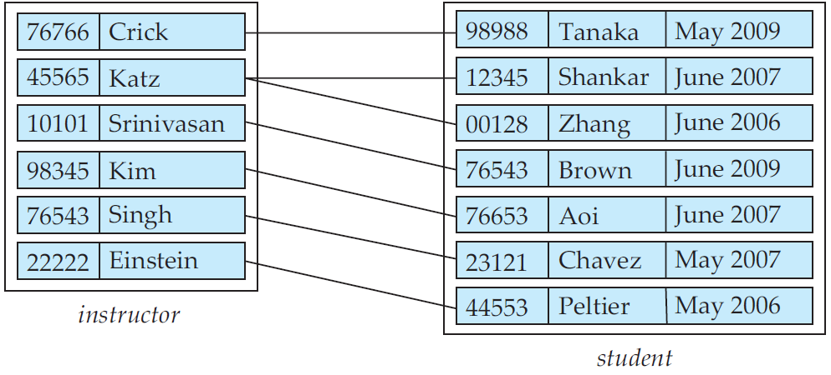
Mapping Cardinalities affect ER Design
In this case, the attribute date could be associated with the student entity set.
Since each student entity participates in a relationship with at most one instance of instructor, making this attribute designation has the same meaning as would placing date with the advisor relationship set.
date

Slide 57
Extended ER Features

Slide 58
Specialization
Top-down design process; we designate sub-groupings within an entity set that are distinctive from other entities in the set.
These sub-groupings become lower-level entity sets that have attributes or participate in relationships that do not apply to the higher-level entity set.
Depicted by a triangle component labeled ISA (e.g., instructor “is a” person).
Attribute inheritance – a lower-level entity set inherits all the attributes and relationship participation of the higher-level entity set to which it is linked.

Slide 59
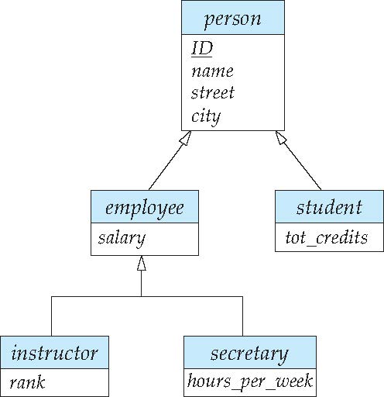
Specialization Example
Overlapping – employee and student
For an overlapping specialization (as is the case for student and employee as specializations of person), two separate arrows are used
Disjoint – instructor and secretary
For a disjoint specialization (as is the case for instructor and secretary as specializations of employee), a single arrow is used
Total and partial
Total：Each higher-level entity must belong to a lower-level entity set.
Partial:Some higher-level entities may not belong to any lower-level entity set.
total

Slide 60
Extended ER Features: Generalization
A bottom-up design process – combine a number of entity sets that share the same features into a higher-level entity set.
Specialization and generalization are simple inversions of each other; they are represented in an E-R diagram in the same way.
The terms specialization and generalization are used interchangeably.

Slide 61
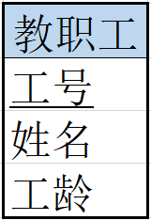
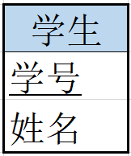
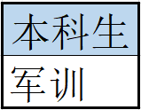
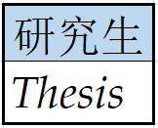
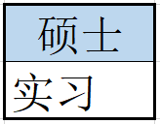
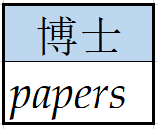
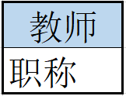
Generalization
ISA
ISA
ISA

Slide 62
Specialization and Generalization (Cont.)
Can have multiple specializations of an entity set based on different features.
E.g., permanent_employee vs. temporary_employee, in addition to instructor vs. secretary
Each particular employee would be
a member of one of permanent_employee or temporary_employee,
and also a member of one of instructor, secretary
The ISA relationship also referred to as superclass - subclass relationship

Slide 63
Design Constraints on a Specialization/Generalization
Constraint on which entities can be members of a given lower-level entity set.
condition-defined
Example: all customers over 65 years are members of senior-citizen entity set; senior-citizen ISA person.
user-defined
Constraint on whether or not entities may belong to more than one lower-level entity set within a single generalization.
Disjoint
an entity can belong to only one lower-level entity set
Noted in E-R diagram by having multiple lower-level entity sets link to the same triangle
Overlapping
an entity can belong to more than one lower-level entity set

Slide 64
Design Constraints on a Specialization/Generalization (Cont.)
Completeness constraint -- specifies whether or not an entity in the higher-level entity set must belong to at least one of the lower-level entity sets within a generalization.
total: an entity must belong to one of the lower-level entity sets
partial: an entity need not belong to one of the lower-level entity sets
学生
ISA
本科生
研究生

Slide 65
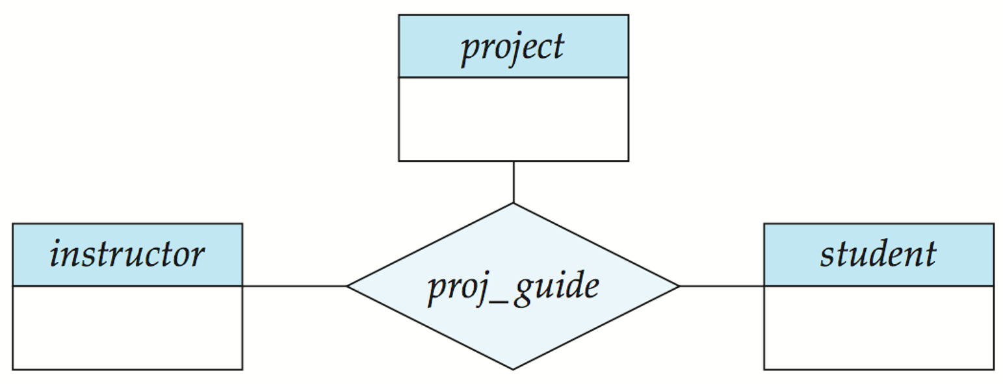
Aggregation
Consider the ternary relationship proj_guide, which we saw earlier
Suppose we want to record evaluations of a student by a guide on a project

Slide 66
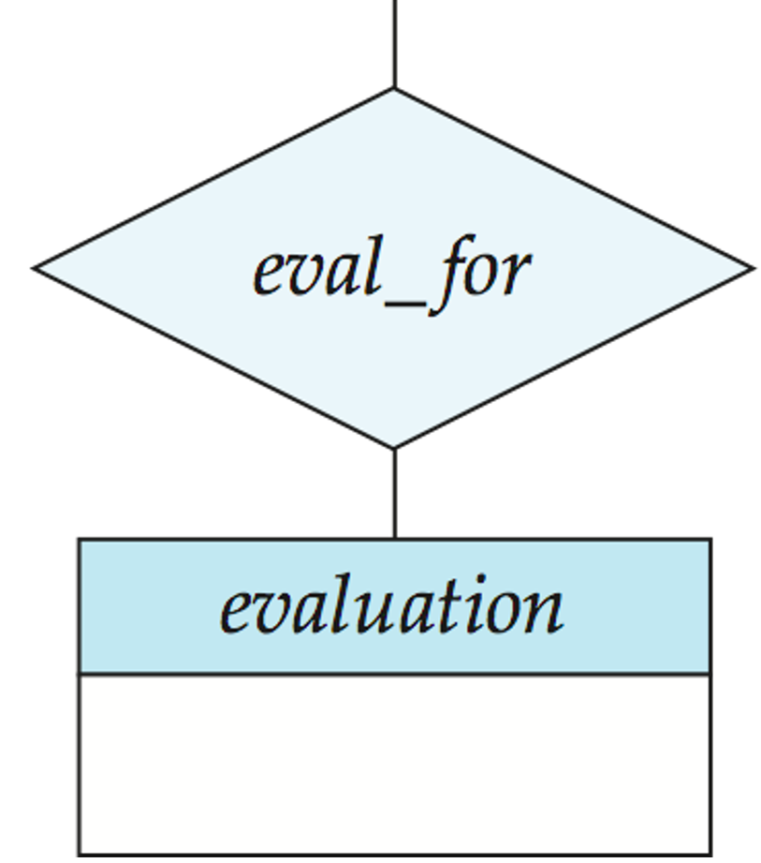
Aggregation
Suppose we want to record evaluations of a student by a guide on a project
Cannot represent which (student, project) combinations of an instructor are evaluated.

Slide 67
Aggregation
Suppose we want to record evaluations of a student by a guide on a project
Some (instructor, student, project ) combination may not be evaluated.

Slide 68
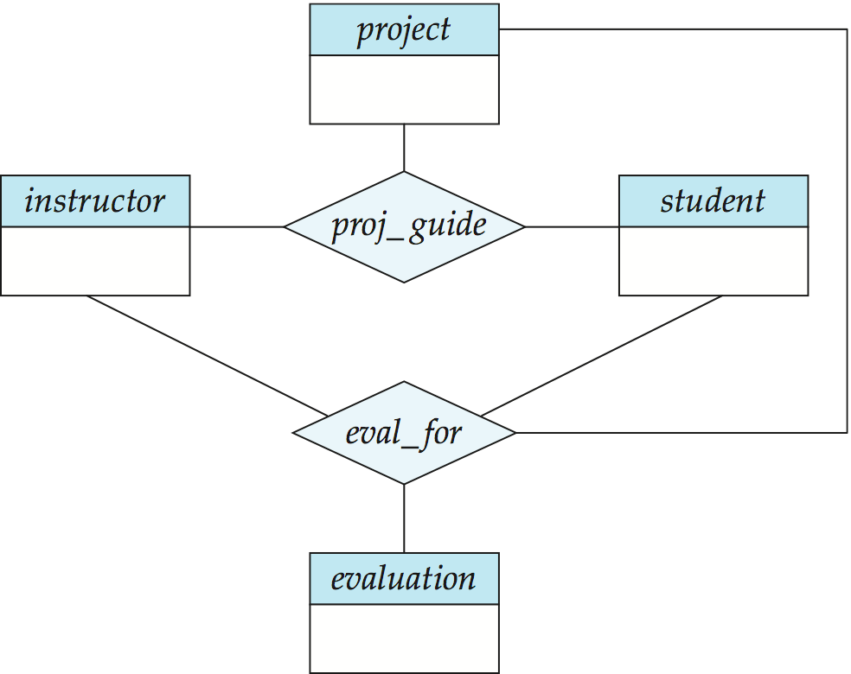
Aggregation
Suppose we want to record evaluations of a student by a guide on a project
There is redundant information since every combination (instructor, student, project ) in eval_for is also in proj_guide.

Slide 69
Aggregation (Cont.)
Relationship sets eval_for and proj_guide represent overlapping information
Every eval_for relationship corresponds to a proj_guide relationship
However, some proj_guide relationships may not correspond to any eval_for relationships
So we can’t discard the proj_guide relationship
Eliminate this redundancy via aggregation
Treat relationship as an abstract entity
Allows relationships between relationships
Abstraction of relationship into new entity

Slide 70
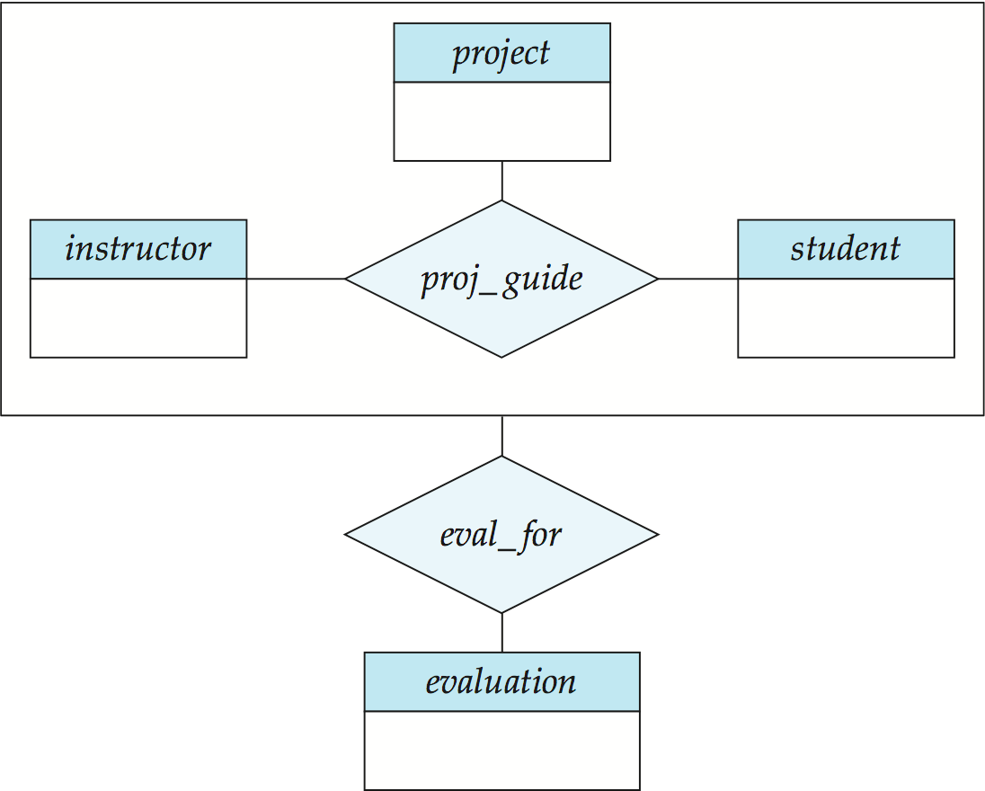
E-R Diagram With Aggregation
Without introducing redundancy, the following diagram represents:
A student is guided by a particular instructor on a particular project
A student, instructor, project combination may have an associated evaluation

Slide 71
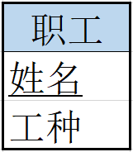
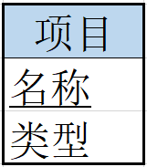
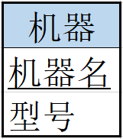
E-R Diagram With Aggregation
联系之间存在重叠，如何表达联系之间的联系？
实例：职工参加项目，并在此过程中可能使用机器
方案1
工时
职工姓名 | 项目名称 | 机器名 | 工时
e1 | j1 | m1 | 3
e1 | j1 | m2 | 3
e1 | j2 | m3 | 4
e2 | j1 | m1 | 5
e3 | j2 | null | 4
e4 | j2 | null | 4
e5 | j2 | null | 6
e6 | j2 | null | 5
参加并使用

Slide 72
E-R Diagram With Aggregation
方案2
职工姓名 | 项目名称 | 工时
e1 | j1 | 3
e1 | j2 | 4
e2 | j1 | 5
e3 | j2 | 4
e4 | j2 | 4
e5 | j2 | 6
e6 | j2 | 5
工时
参加
使用
职工姓名 | 机器名
e1 | m1
e1 | m2
e1 | m3
e2 | m1
e1在j1项目中使用什么机器？

Slide 73
E-R Diagram With Aggregation
方案3
职工姓名 | 项目名称 | 工时
e1 | j1 | 3
e1 | j2 | 4
e2 | j1 | 5
e3 | j2 | 4
e4 | j2 | 4
e5 | j2 | 6
e6 | j2 | 5
工时
参加
使用
职工姓名 | 项目名称 | 机器名
e1 | j1 | m1
e1 | j1 | m2
e1 | j2 | m3
e2 | j1 | m1

Slide 74
E-R Design Decisions
The use of an attribute or entity set to represent an object.
Whether a real-world concept is best expressed by an entity set or a relationship set.
The use of a ternary relationship versus a pair of binary relationships.
The use of a strong or weak entity set.
The use of specialization/generalization – contributes to modularity in the design.
The use of aggregation – can treat the aggregate entity set as a single unit without concern for the details of its internal structure.

Slide 75
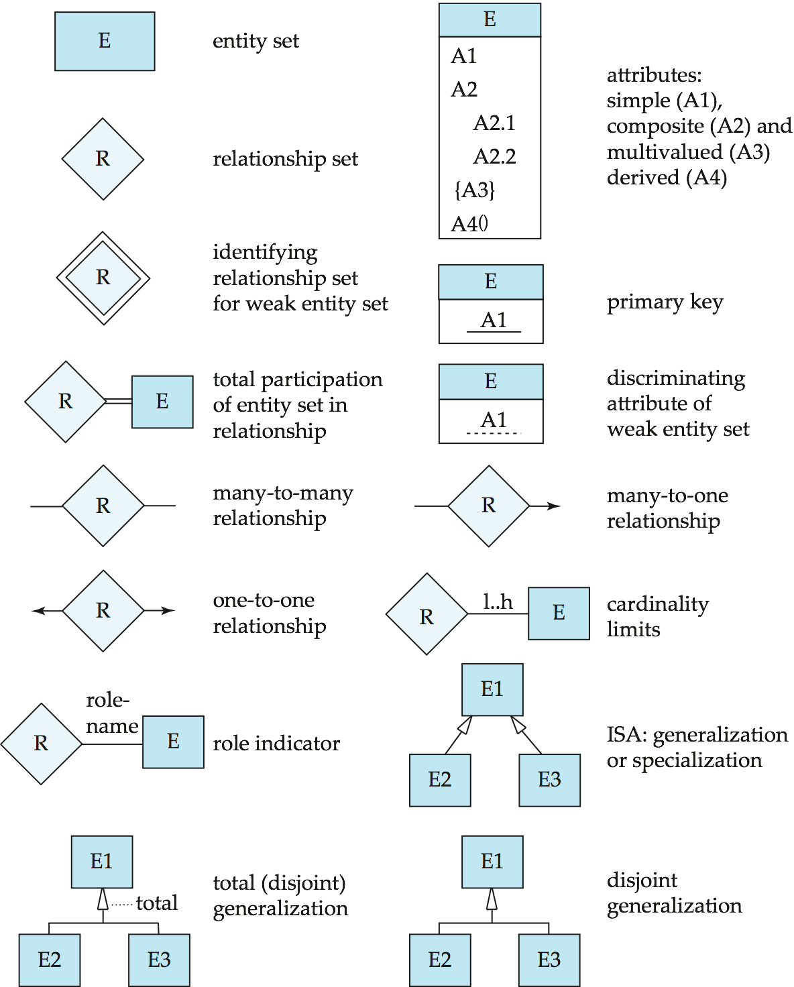
Summary of Symbols Used in E-R Notation

Slide 76
Symbols Used in E-R Notation (Cont.)

Slide 77
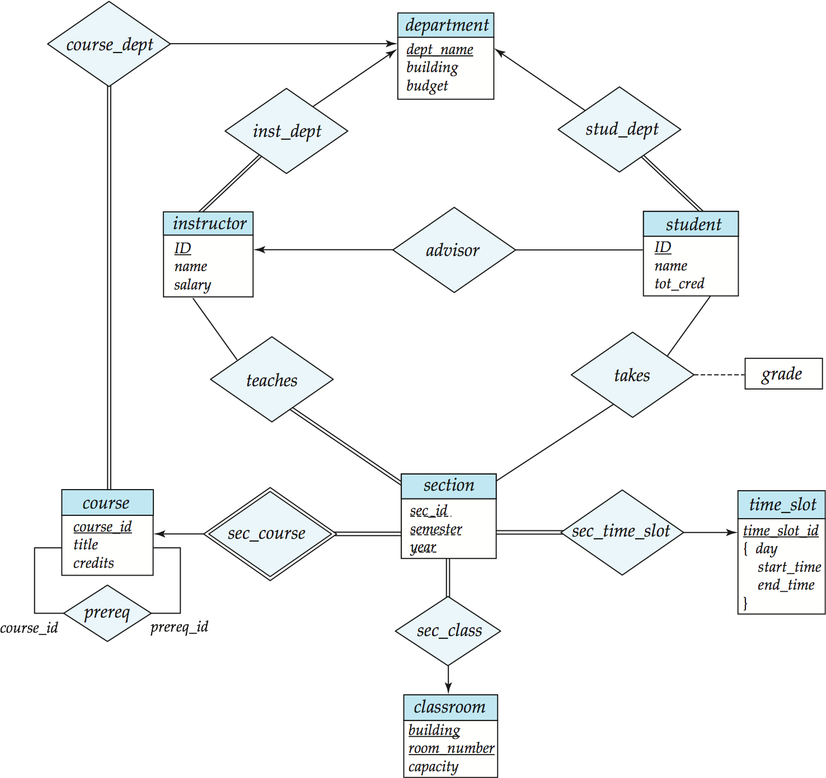
E-R Diagram for a University Enterprise

Slide 78
How about doing another ER design interactively on the board?

Slide 79
Design ER Model
设计E-R图过程(方法一)
首先确定实体类型：几个实体类型及相应的实体名
确定联系类型：各实体类型之间是否有联系，是何种联系类型及相应的联系名
连接实体类型和联系类型，组合成E-R图
确定实体类型和联系类型的属性
确定实体类型的码

Slide 80
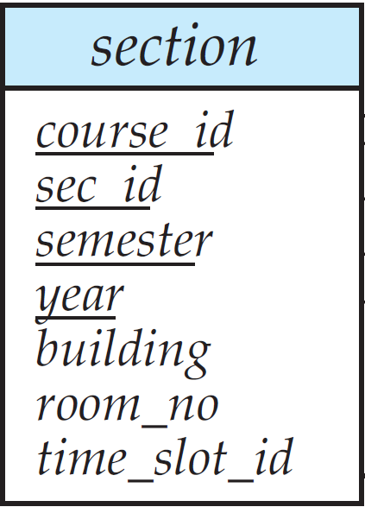
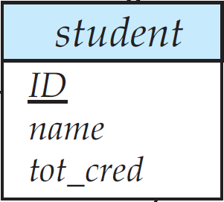

Design ER Model
实体与联系用线段连接并注明类型
Example：学生选修课程
用矩形表
示实体
确定实体的属性
m
n
确定实体类型的码
用菱形表示实体间的联系

Slide 81
Design ER Model
设计E-R图过程(方法二)
首先确定实体类型：几个实体类型及相应的实体名
确定实体类型的属性；
确定联系类型，及其属性；
把实体类型和联系类型组合成E-R图；
加上实体和联系的属性，并确定实体类型的码。

Slide 82
Design ER Model
Example：构造某个工厂物资管理的E-R模型
物资管理涉及的实体有：
仓库 零件 供应商 项目 职工
确定这些实体的属性有：
仓库 —— 属性有仓库号、面积、电话号码。
零件 —— 属性有零件号、名称、规格、单价、描述。
供应商 —— 属性有供应商号、姓名、地址、电话号码、账号。
项目 —— 属性有项目号、预算、开工日期。
职工 —— 属性有职工号、姓名、年龄、职称。

Slide 83





Design ER Model
a. 实体及其属性图

Slide 84
Design ER Model
确定这些实体之间的联系如下：
一个仓库可以存放多种零件，一种零件可以存放在多个仓库中，因此仓库和零件具有多对多的联系。用库存量来表示某种零件在某个仓库中的数量。
一个仓库有多个职工当仓库保管员，一个职工只能在一个仓库工作，因此仓库和职工之间是一对多的联系。
职工之间具有领导-被领导关系。即仓库主任领导若干保管员，因此职工实体集中具有一对多的联系。
供应商、项目和零件三者之间具有多对多的联系。即一个供应商可以供给若干项目多种零件，每个项目可以使用不同供应商供应的零件，每种零件可由不同供应商供给。

Slide 85
Design ER Model
1
工作
n
供应商
仓库
职工
供应量
m
m
1
n
供应
存放
领导
库存量
n
p
n
项目
零件
确定联系的属性
b. 实体及其联系图

Slide 86
1
工作
n
供应量
m
m
1
n
供应
存放
领导
库存量
n
p
n
c. 完整的实体-联系图

Slide 87
Reduction to Relational Schemas

Slide 88
E-R模型向关系模式的转换
实体 → 关系
属性 → 关系的属性
学生
学号
姓名
系别
学生（学号，姓名，系别）

Slide 89
E-R模型向关系模式的转换
复合属性 → 将每个组合属性作为复合属性所在实体的属性
学生
学号
出生日期
年
月
日
姓名
学生（学号，姓名，年，月，日）

Slide 90
E-R模型向关系模式的转换
多值属性 → 新的关系+所在实体的码
学生
学号
姓名
{所选课程}
学生（学号，姓名）
选修（学号，课程号）

Slide 91
E-R模型向关系模式的转换
一对多联系：将单方参与实体的码作为多方参与实体的属性
教职工
工号
姓名
学生
学号
姓名
系别
班主任
教师（工号，姓名）
学生（学号，姓名，系别，班主任工号）

Slide 92
E-R模型向关系模式的转换
职工
职工号
姓名
年龄
职称
属下
领导
领导
职工（职工号，姓名，年龄，职称，领导职工号）

Slide 93
E-R模型向关系模式的转换
多对多联系：将联系定义为新的关系，属性为参与双方的码
学生
学号
姓名
课程
课程号
课程名
学分
选修
学生（学号，姓名）
课程（课程号，课程名，学分）
选修（学号，课程号）

Slide 94
E-R模型向关系模式的转换
零件
零件号
名称
母零件
构成
子零件
零件（零件号，名称）
构成（母零件号，子零件号）

Slide 95
E-R模型向关系模式的转换
一对一联系：若联系一方全部参与，则将联系另一方的码作为全部参与一方的属性
职工
职工号
姓名
管理
部门
部门号
部门名
部门（部门号，部门名，领导的职工号）
职工（职工号，姓名）

Slide 96
E-R模型向关系模式的转换
弱实体集：所对应的关系的码由弱实体集本身的分辩符再加上所依赖的强实体集的码
制造
公司
公司名
地址
联系电话
产品
产品名
价格
产品（产品名，价格，公司名）
公司（公司名，地址，联系电话）

Slide 97
E-R模型向关系模式的转换
概括：方法一：高层实体集和低层实体集分别转为表，低层实体集所对应的关系仅包括高层实体集的主码
教职工（工号，姓名，工龄）
教师（工号，职称）
博士（工号，发表论文）
ISA
缺点：访问低层实体的时候，如获取博士信息，需要同时访问对应的高层实体（姓名、工龄）和低层实体（工号、发表论文）。

Slide 98
E-R模型向关系模式的转换
概括：方法二：高层实体集和低层实体集分别转为表，低层实体集所对应的关系包括所有从高层实体集继承的属性
教职工（工号，姓名，工龄）
教师（工号，姓名，工龄，职称）
博士（工号，姓名，工龄，发表论文）
ISA
缺点：对于读博士的老师，（工号、姓名、工龄）等信息冗余

Slide 99
E-R模型向关系模式的转换
条件：如果概括是不相交并且是全部的，即一个高层实体最多并且只能属于一个低层实体集，则可以不为高层实体集建立关系，低层实体集所对应的关系包括上层实体集的的所有属性
本科生（学号，姓名，军训）
ISA
硕士（学号，姓名，毕业论文，实习）
ISA
博士（学号，姓名，毕业论文，发表论文）

Slide 100
E-R模型向关系模式的转换
聚集：实体集A与B以及它们的联系R被看成实体集C，C与另一实体集D构成联系S，则S所对应的关系的码由R和D的码构成
工时
参加
使用

Slide 101
E-R模型向关系模式的转换
职工（姓名，工种）
项目（名称，类型）
参加（姓名，名称，工时）
机器（机器名，型号）
使用（姓名，名称，机器名）

Slide 102
Assignments
7.21, 7.23, Exercise
And reduce all of your ER models to relational schemas

Slide 103
Exercise: ABC Banks
The bank is organized into branches. Each branch is located in a particular city and is identified by a unique name. Each year the bank’s board defines the yearly budget and the rating (which is a number from 1 to 10) for each branch.
A bank customer is identified by their customers’ name and phone number. The bank also keeps track of each customer’s current address.
The bank offers accounts and loans to its customers. Each account and loan has a unique number and is created and maintained by a single branch.
Each account is assigned to one or more customers and its balance can never be negative. Each customer also can have one or more accounts.
A loan is always assigned to a single customer, has a fixed interest rate and its balance cannot be negative either. Each customer can borrow one or more loans.
A payment is paid separately for each loan, which was recorded as its number, date and amount. For each loan, a payment number uniquely identifies on single payment for that loan.
A payment may be associated with an account, identifying the account from which the payment was made.

Slide 104
End of Chapter

